Slide 1
CENTRAL INSTITUTE FOR SUPERVISING
AND TESTING IN AGRICULTURE
ISO 9001:2015
www.ukzuz.cz
Legislative changes concerning the PPP‘s in the Czech Republic
Alena Pernicova
Josef Svoboda

Slide 2
Central Institute for Supervising and Testing in Agriculture is:
specialised body of state administration established by Act No 147/2002 Coll.
organisational unit of the state system
administrative authority, subordinated to the Ministry of Agriculture
holder of ISO 9001:2015 certificate for performance of administration, official control and related testing in the area of agricultural inputs
the headquarters of the Institute are in Brno and its activities are performed at workplaces throughout the Czech Republic

Slide 3
UKZUZ performs administrative proceedings and carries out some other administrative activities, expert and testing tasks and control and monitoring activities in the areas of:
PLANT PROTECTION PRODUCTS
FERTILISERS AND SOIL
PLANT HEALTH CARE
FEED
ORGANIC AGRICULTURE
PERENNIAL PLANTS
PLANT VARIETIES
SEED AND PLANTING MATERIAL
www.ukzuz.cz

Slide 4
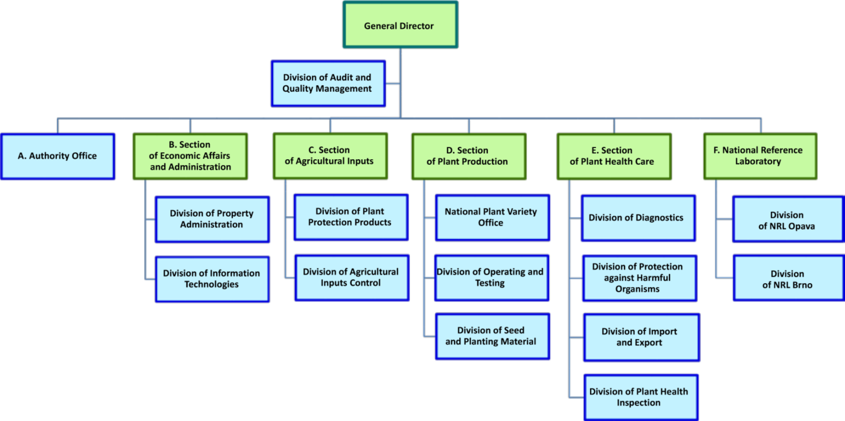
ORGANIZATIONAL STRUCTURE
www.ukzuz.cz

Slide 5
National legislations
Act No 326/2004 Coll., on phytosanitary care and changes of some other related acts
At last amended 1. 12. 2017
Decree No 132/2018 Coll., on plant protection products
Effectiveness since July 2018

Slide 6
Fight againts illegal product News in CZ legislation
The original label must not be removed by label from parallel trade
Legal requirements to label since 1. 1. 2020
sequence of data
2D codes
Only the authorisation holders of PPP can repackage
Electronic records about distribution linked to 2D codes
since 1. 1. 2020

Slide 7
Fight againts illegal product News in CZ legislation
Register of distributors of PPP‘s for proffessional users
Good distribution practice in the Act
The paraller trade holder must inform the Institute about revocation of the authorisation in relevant MS

Slide 8
Fight againts illegal product News in CZ legislation
Obligation information about import or relocation of the PPP‘s to the territory of the Czech Republic – includes also PPP´s, which are not intended for the Czech market, 3 days before import
Obligation information from producer PPP‘s in CZ – once every 3 months
Customs Administration is phytosanitary care institute and provides information to ÚKZÚZ about import of PPP‘s from third countries
Increasing the limit for sanctions

Slide 9
2D codes – current CZ status
The current version of the Decree requires label of all PPP´s on the market in CZ by 2D codes from 1. 1. 2020
2D code have to included batch number and production date
Every distributors have to keep records about PPP‘s in electronic form
This records will have to be interconnected with 2D codes

Slide 10
2D codes – vision of ÚKZÚZ
To label by 2D codes only PPP‘s and auxiliary products, which are made after 1. 1. 2020
Only distributor of PPP‘s for professional users will have to keep records in electronic form.
Determination of technical parameters for 2D codes (usage GTIN ?) – Global Trade Item Number
Each distributor of PPP‘s for professional users will have to communicate/send the information (2D codes) about distribution PPP‘s to ÚKZÚZ (MoA) database
ÚKZÚZ will be inform about each move of PPP´s – traceability on the market in CZ

Slide 11
Activities in future
Implementation of changes in national (CZ) legislation
2019 – 2020 project for implementation 2D codes - cooperation with CCPA and private industry

Slide 12
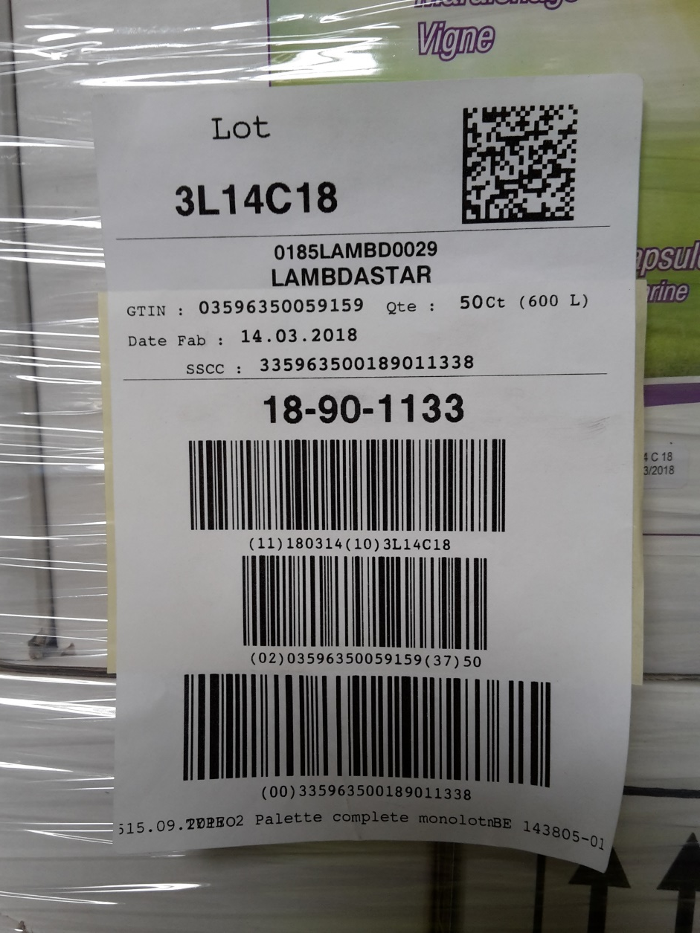

Slide 13
Thank you for your attention

